Slide 1

SAP BTP ABAP on Cloud / RAP Training
DAY-11
Anubhav Oberoy
www.AnubhavTrainings.com
Follow excellence with sheer passion

Slide 2


DISCLAIMER
The training content and delivery of this presentation is confidential, and cannot be recorded, or copied and distributed to any third party, without the written consent of Anubhav Trainings

Slide 3

01
Authorization
02
Prechecks
03
Augment
04
Virtual Elements
Notes:
https://pixabay.com/photos/san-francisco-transamerica-pyramid-1633203/

Slide 4

Development Flow – Processor and Approver
Fiori App – Processor
Create, update, delete, copy travel
Fiori App – Approver
Display the travel request data
Service definition
Service Binding
Service definition
Service Binding
MDE for Processor Projection
MDE for approver Projection
BDEF Projection
For Processor
Expose what is needed by a processor role in company
Behavior Definition (BDEF)
Tell RAP framework regarding our operations which needs to be supported for BO (managed)
BDEF Projection
For Approver
Expose what is needed by a approver role in company
Business Object Projection
For Processor
30 fields to internet
Business Object (definition)
Includes the Travel, Booking and Booking Supplement CDS entities
100 fields
Business Object Projection
For Approver
25 fields
www.anubhavtrainings.com

Slide 5
Steps to implement the approver scenario
Go to base behavior definition and add non factory actions, provide implementation for the same
Create copy from processor cds entity projections and make new cds entities for projection for approver. Both travel and booking, ignore the booking supplement as a approver will only allowed to view upto the booking data.
Create metadata extensions for approver. Since approver can only see the data of travel and booking, we only created 2 MDE. Keep all the relevant fields and integrate code to show accept and reject travel buttons.
Now we provide behavior definition projection for approver which controls what an approver can do. As we know an approver can only edit bookingfee and travel status, he/she not allowed to create/update/delete any of the entities.
Customize our BDEF according to the needs of our user scenario.
Create a service definition for approver and service binding for approver.
Testing ☺
www.anubhavtrainings.com

Slide 6
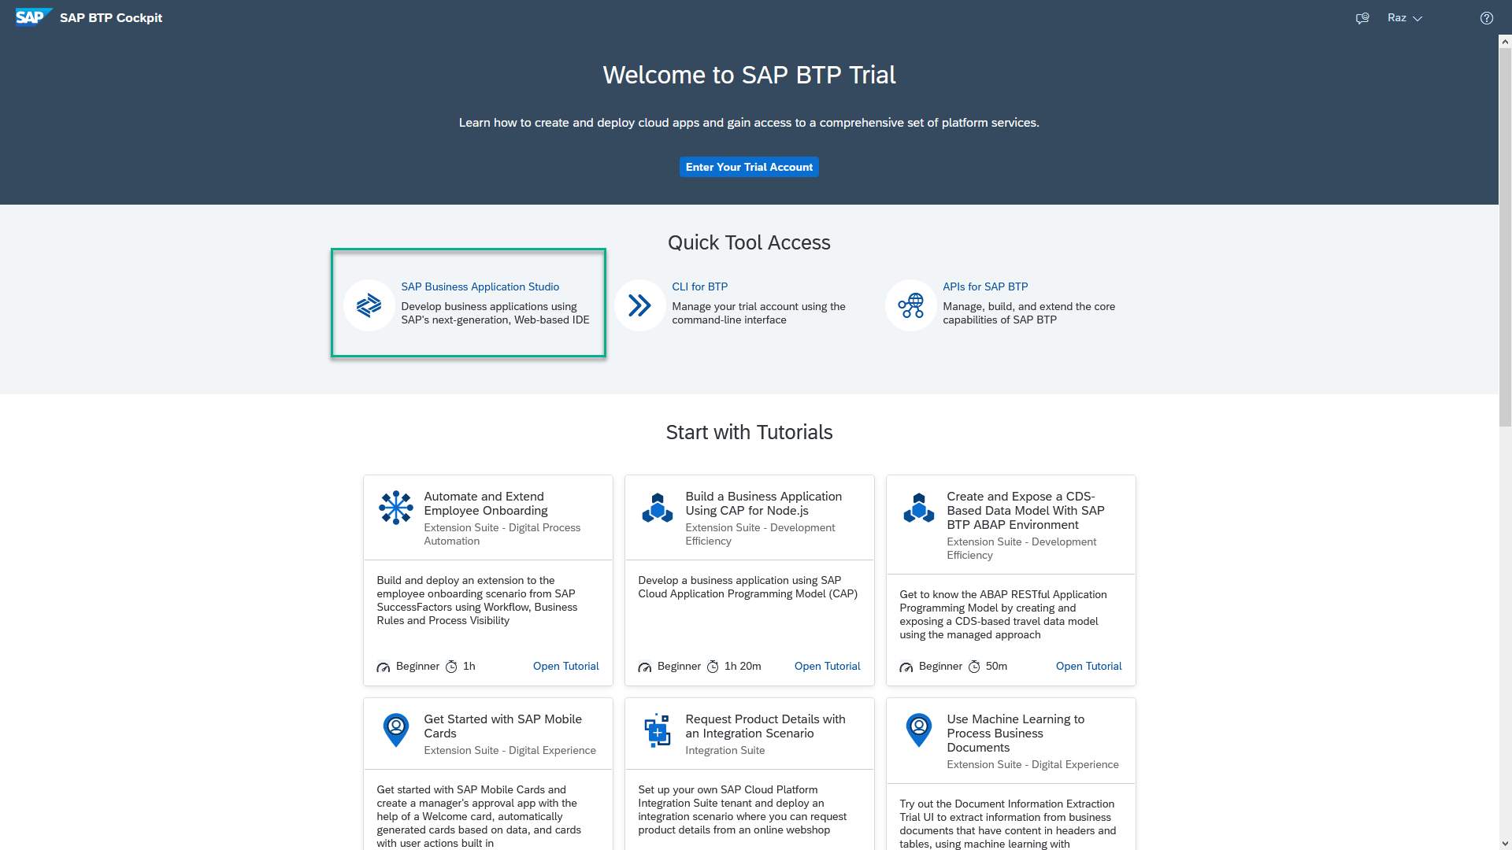
Business Application Studio
SAP Business Application Studio is a development environment available on SAP Business Technology Platform. It is a multi cloud development environment to create different kinds of Apps like HANA Native, CAPM, Fiori, MDK etc. A developer must create private dev space in the system in order to build application in BAS tool, All the required tooling is pre-configured in BAS.
In an Enterprise Account you can set up SAP Business Application Studio as a Free-Tier service by checking its free plan during its entitlement configuration.

Slide 7
Dev Space in BAS
We don’t want a single developer to consume all the available resources
We want a clear isolation of one developer with another
Pre-configured by sap for specific development
Solution - Virtualize
Dev Space
Dev Space
Dev Space
SAP BAS – Business App Studio
SAP BTP – Platform as a Service
IaaS – Infrastructure as a Service

Slide 8
www.anubhavtrainings.com
Thank You
End of Day 11
www.anubhavtrainings.com

Slide 9


We’re committed to empower you to be
#FutureReady
through powerful training solutions.
We build the workforce of the future.
250+
Corporate Clients
30,000+
Learners Trained
25000+
Learners Placed
FREE WEBINARS
Sign up for free webinars with industry experts every fortnight!
Enroll Now!
Contact us today!
https://anubhavtrainings.com

